Slide 1
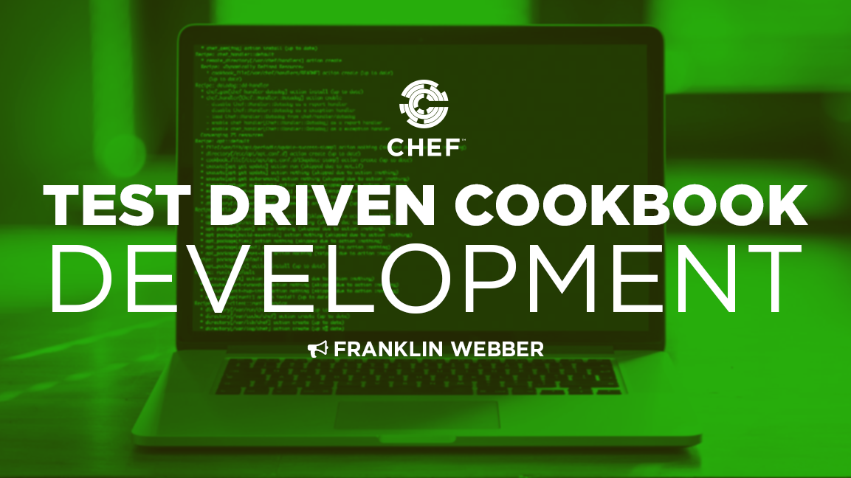
Test Driven Cookbook Development
Notes:
Welcome to Test Driven Cookbook Development.

Slide 2

Franklin Webber
Training and Technical Content Lead
US Army - Radio/COMSEC Repairer (35E)
Tech Support
Quality Assurance
Software Developer Eng. in Test
Software Developer
Instructor / Trainer
Notes:
Before we start let me introduce myself.

Slide 3
You
Chef Cookbook Author
Great Looking
Understand Chef Resources and Cookbooks
Interested in Testing and know a little about Chef Testing Tools

Slide 4
Schedule
@ 3 min – Housekeeping
@ 6 min – Slides & Live Demonstration
@ 45 min – Questions
@ 57 min – Wrap-up

Slide 5
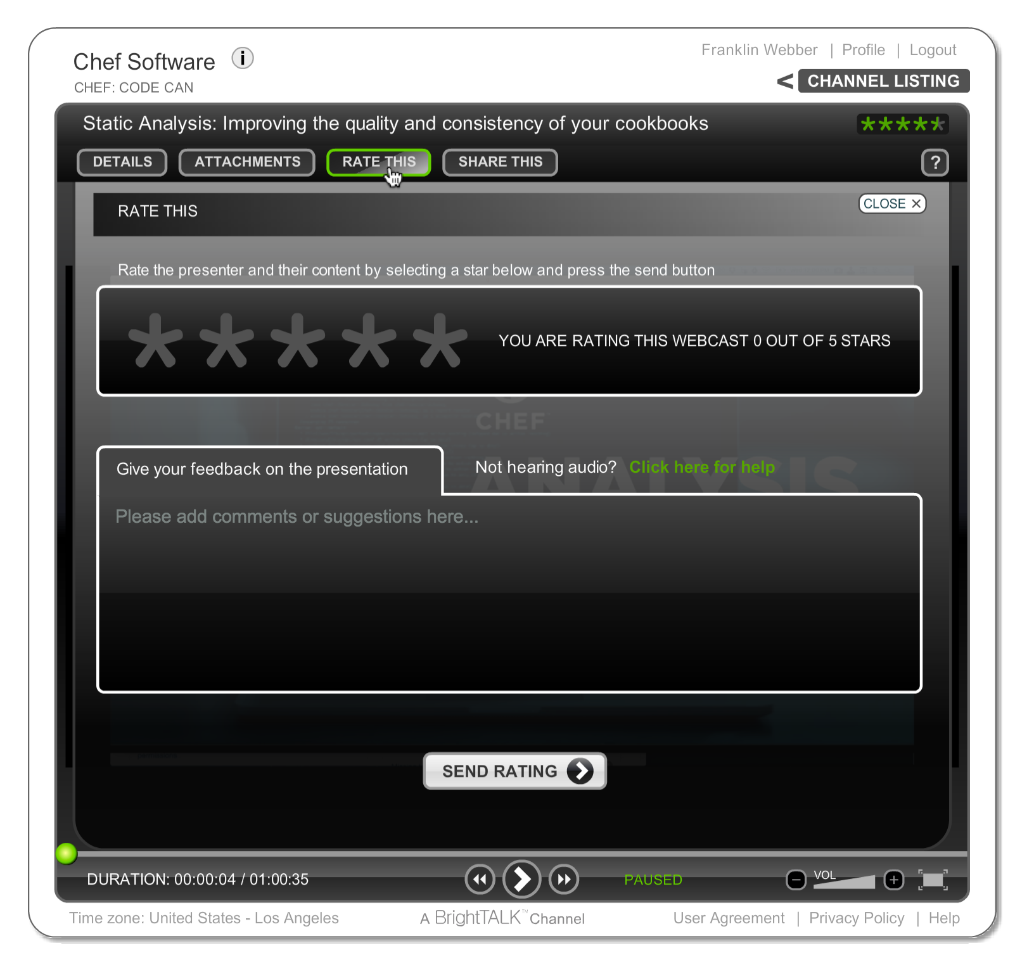
Let Us Know What You Think
"Ask a Question" and I will answer it.
"Rate This" presentation to leave your feedback and help me do my work better.

Slide 6
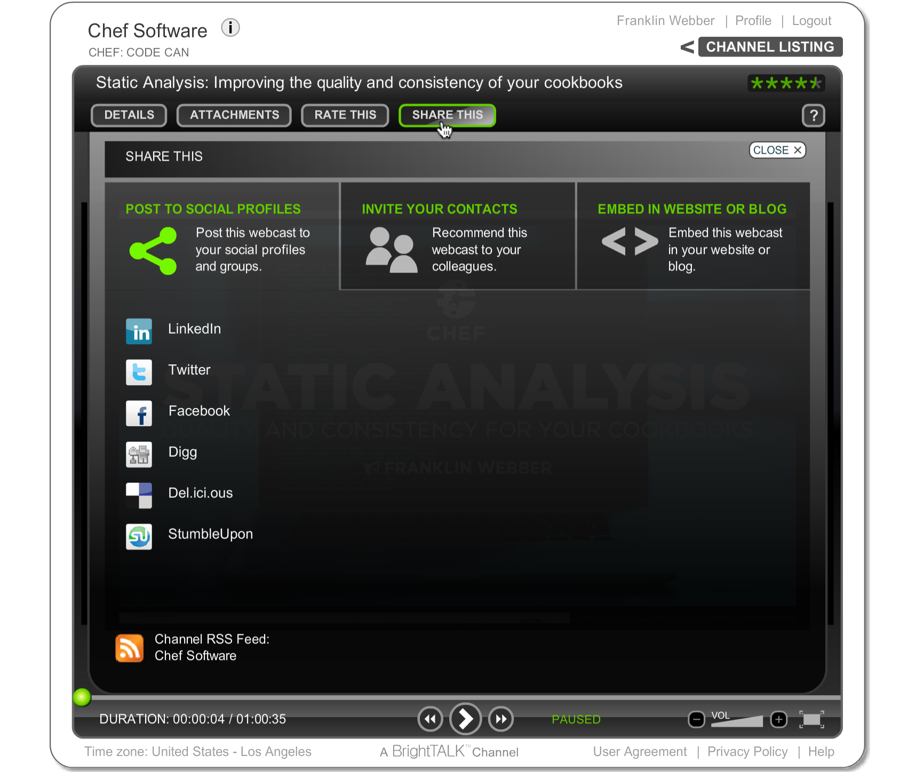
Was this Valuable to You?
Share it with your professional and social networks.

Slide 7
Test Driven Cookbook Development
Notes:
Welcome to Test Driven Cookbook Development.

Slide 8
Agenda
What is Test Driven Development (TDD)?
Writing a test first
Refactoring with tests
Faster Feedback with Unit Tests
Further Resources

Slide 9
Test Driven Development
Define a test set for the unit first
Then implement the unit
Finally verify that the implementation of the unit makes the tests succeed.
Refactor
Notes:
Test Driven Development (TDD) is a workflow that asks you to perform that act continually and repeatedly as you satisfy the requirements of the work you have chosen to perform.
TDD generically focuses on the unit of software any level. It is the process of writing the test first, implementing the unit, and then verifying the implementation with the test that was written.
A 'unit' of software is purposefully vague. This 'unit' is definable by the individuals developing the software. So the size of a 'unit of software' likely has different meanings to different individuals based on our backgrounds and experiences.

Slide 10
Behavior Driven Development (BDD)
Behavior-driven development (BDD) specifies that tests of any unit of software should be specified in terms of the desired behavior of the unit.
Borrowing from agile software development the "desired behavior" in this case consists of the requirements set by the business — that is, the desired behavior that has business value for whatever entity commissioned the software unit under construction.
Within BDD practice, this is referred to as BDD being an "outside-in" activity.
Notes:
How you choose to express the requirements of that unit is the crux of Behavior Driven Development (BDD). Behavior-driven development specifies that tests of any unit of software should be specified in terms of the desired behavior of the unit. Expressing this desired behavior is often expressed in scenarios that are written in a Domain Specific Language (DSL).
The cookbooks and recipes that you have written so far share quite a few similarities with BDD. In Chef, you express the desired state of the system through a DSL, resources, you define in recipes.

Slide 11
TDD and BDD
TDD is a workflow process.
BDD influences the language we use to write tests and how we focus on the tests that matter.
Notes:
TDD is a workflow process: Add a test; Run the test expecting failure; Add code; Run the test expecting success. Refactor.
BDD influences the language we use to write the tests and how we focus on test that matter. The activities within this module focus on the process of taking requirements, expressing them as expectations, choosing one implementation to meet these expectations, and then verifying we have met these expectations.

Slide 12
Building a Web Server
Install the httpd package
Write out a test page
Start and enable the httpd service
Notes:
To explore the concepts of Test Driven Development through Behavior Driven Design we are going to focus on creating a cookbook that starts with the goal that installs, configures, and starts a web server that hosts the your company's future home page.
This cookbook will start very straight-forward and over the course of these modules we will introduce new requirements that will increase its complexity.
The goal again is to focus on the TDD workflow and understanding how to apply BDD when defining these tests. We are not concerned about focusing on best practices for managing web servers or modeling a more initially complex cookbook.

Slide 13
Scenario: Potential User Visits Website
Given that I am a potential user
When I visit the company website in my browser
Then I should see a welcome message
Notes:
The typical reason for setting up a website is to allow customers, users, potential users to learn more about the company. The needs of the website may change in the future but the first minimum viable product (MVP) is to simply give our users the ability to find out more information.
Our goal now is to define a scenario with this understanding.
This first scenario is enough information to help us build this cookbook with a TDD approach. This practice of defining a scenario is a tactic that I employ to help focus me on the most valuable work that needs to be done.
Important things to notice in the following scenario is the distinct lack of technology or implementation. The scenario is not concerned about the services that are running or files that might be found on the file system.

Slide 14
‘Integration’ Testing
‘Unit’ Testing
Test Kitchen using RSpec with ServerSpec as the verifier
RSpec with ChefSpec

Slide 15
Agenda
What is Test Driven Development (TDD)?
Writing a test first
Refactoring with tests
Faster Feedback with Unit Tests
Further Resources

Slide 16
Let's Start this Journey in the Home Directory
> cd ~
Notes:
Let's start the journey on your workstation. From the home directory we are going to creating this cookbook.

Slide 17
Generate a Cookbook
> chef generate cookbook httpd
Compiling Cookbooks...
Recipe: code_generator::cookbook
* directory[/home/chef/httpd] action create
- create new directory /home/chef/httpd
* template[/home/chef/httpd/metadata.rb] action create_if_missing
- create new file /home/chef/httpd/metadata.rb
- update content in file /home/chef/httpd/metadata.rb from none to 53a150
(diff output suppressed by config)
* template[/home/chef/httpd/README.md] action create_if_missing
Notes:
Let's generate cookbook named 'httpd'. The name of the cookbook here resembles the name of a public cookbook in the Supermarket that accomplishes a very similar task. That is the reason why I have asked you to chose the same name.
Sharing the same name as a cookbook within the Supermarket can be problematic. While we may never share this cookbook other individuals within our organization could believe it to be a copy of that cookbook. When it comes to naming cookbooks it may be wise to first search the Supermarket and ensure you are not using a similar name.

Slide 18
View the Tests in the Generated Cookbook
> tree httpd
httpd
└── test
└── integration
├── default
│ └── serverspec
│ └── default_spec.rb
└── helpers
└── serverspec
└── spec_helper.rb
Notes:
We can examine the contents of the cookbook that chef generated for us. Here you see that the tool created for us a complete test directory structure.

Slide 19
RSpec and ServerSpec
RSpec is a Domain Specific Language (DSL) that allows you to express and execute expectations. These expectations are expressed in examples that are asserted in different example groups.
ServerSpec provides helpers and tools that allow you to express expectations about the state of infrastructure.
ServerSpec
RSpec
Chef
Ruby
Notes:
RSpec is a Behavior Driven Development (BDD) framework that uses a natural language domain-specific language (DSL) to quickly describe scenarios in which systems are being tested. RSpec allows you to setup a scenario, execute the scenario, and then define expectations on the results. These expectations are expressed in examples that are asserted in different example groups.
RSpec by itself grants us the framework, language, and tools. ServerSpec provides the knowledge about expressing expectations about the state of infrastructure.

Slide 20
Auto-generated Spec File in Cookbook
~/httpd/test/integration/default/serverspec/default_spec.rb
require 'spec_helper'
describe 'httpd::default' do
# Serverspec examples can be found at
# http://serverspec.org/resource_types.html
it 'does something' do
skip 'Replace this with meaningful tests'
end
end
Notes:
The generator created an example specification (or spec) file. Before we talk about the RSpec/ServerSpec language lets explain the long file path and its importance.

Slide 21
Where do Tests Live?
~/httpd/test/integration/default/serverspec/default_spec.rb
Test Kitchen will look for tests to run under this directory. It allows you to put unit or other tests in test/unit, spec, acceptance, or wherever without mixing them up. This is configurable, if desired.
http://kitchen.ci/docs/getting-started/writing-test
Notes:
Let's take a moment to describe the reason behind this long directory path. Within our cookbook we define a test directory and within that test directory we define another directory named 'integration'. This is the basic file path that Test Kitchen expects to find the specifications that we have defined.

Slide 22
Where do Tests Live?
~/httpd/test/integration/default/serverspec/default_spec.rb
This corresponds exactly to the Suite name we set up in the .kitchen.yml file. If we had a suite called "server-only", then you would put tests for the server only suite under.
http://kitchen.ci/docs/getting-started/writing-test
Notes:
The next part the path, 'default', corresponds to the name of the test suite that is defined in the .kitchen.yml file. In our case the name of the suite is 'default' so when test kitchen performs a `kitchen verify` for the default suite it will look within the 'default' folder for the specifications to run.

Slide 23
Where do Tests Live?
~/httpd/test/integration/default/serverspec/default_spec.rb
This tells Test Kitchen (and Busser) which Busser runner plugin needs to be installed on the remote instance.
http://kitchen.ci/docs/getting-started/writing-test
Notes:
'serverspec' is the kind of tests that we want to define. Test Kitchen supports a number of testing frameworks.

Slide 24
Where do Tests Live?
~/httpd/test/integration/default/serverspec/default_spec.rb
All test files (or specs) are named after the recipe they test and end with the suffix "_spec.rb". A spec missing that will not be found when executing kitchen verify.
http://kitchen.ci/docs/getting-started/writing-test
Notes:
'serverspec' is the kind of tests that we want to define. Test Kitchen supports a number of testing frameworks.
Now that we understand the path let's take a look at the RSpec/ServerSpec language.

Slide 25
ServerSpec Example
describe 'httpd::default' do
describe command('curl http://localhost') do
its(:stdout) { should match(/Welcome Home/) }
end
end
example groups
Notes:
ServerSpec allows you to scope the expectations you write into groups. These groups are given names or ServerSpec resources to help describe their scope. Example groups can be nested and often are to describe a hierarchical structure of state.
In this example we see an outer example group with the name 'http::default' and the inner example group with the ServerSpec resource named command. This means that the command example group is within the example group 'httpd::default'.
Example groups can be used to show relationship, like they are done here. They can also be used to create unique scenarios with different states for the system.

Slide 26
Components of a ServerSpec Example
cookbook name::suite name
describe 'httpd::default' do
describe command('curl http://localhost') do
its(:stdout) { should match(/Welcome Home/) }
end
end
ServerSpec resource
attribute of resource
expectation
http://serverspec.org/resource_types.html
Notes:
The outermost describe here represents the cookbook name and the recipe name. The inner expectation is using a ServerSpec resource named command. This command resource takes a parameter which is the command it will run. Within the inner example group we are asking for an attribute on the ServerSpec command resource. A command resource is one of the few resources that has attributes you can query. In this instance the example is asking for the standard out, abbreviated as 'stdout'. Lastly we express an expectation that we expect the actual result returned from the standard out to contain the text 'Welcome Home'.
Instructor Note: You are not actually testing against the recipe with Test Kitchen. You are testing against the test suite, defined in the kitchen configuration, which has the name default. That test suite defines a run list and that could contain a number of different recipes. ServerSpec choosing 'cookbook name'::'recipe name' seems misleading.

Slide 27
Remove the Default Test
~/httpd/test/integration/default/serverspec/default_spec.rb
require 'spec_helper'
describe 'httpd::default' do
# Serverspec examples can be found at
# http://serverspec.org/resource_types.html
it 'does something' do
skip 'Replace this with meaningful tests'
end
end
-
Notes:
Within the test file found at the following path you will find that it is already populated some initial code. The first two lines are comments to the ServerSpec documentation. The next three lines are a placeholder test that when executed notifies you that this test is skipped.
We do not need these comments or the placeholder test so let's remove it from the test file.

Slide 28
Add a Test to Validate a Working Website
~/httpd/test/integration/default/serverspec/default_spec.rb
require 'spec_helper'
describe 'httpd::default' do
describe command('curl http://localhost') do
its(:stdout) { should match(/Welcome Home/) }
end
end
+
Notes:
Define the following expectation that states that when we would visit that site it should return a welcoming message.
ServerSpec provides a helper method that allows you to specify a command. That command returns the results from the command through standard out. We are asking the command's standard out if anywhere in the results match the value 'Welcome Home'.

Slide 29
Kitchen Create
$ kitchen create [INSTANCE|REGEXP|all]
Create one or more instances.
Create CentOS Instance
Notes:
Create or turn on a virtual or cloud instance for the platforms specified in the kitchen configuration.
Running 'kitchen create default-centos-67' would create the the one instance that uses the test suite on the platform we want.
Typing in that name would be tiring if you had a lot of instances. A shortcut can be used to target the same system 'kitchen create default' or 'kitchen create centos' or even 'kitchen create 67'. This is an example of using the Regular Expression (REGEXP) to specify an instance.
When you want to target all of the instances you can run 'kitchen create' without any parameters. This will create all instances. Seeing as how there is only one instance this will work well.
In our case, this command would use the Docker driver to create a docker image based on centos-6.7.

Slide 30
Kitchen Converge
$ kitchen converge [INSTANCE|REGEXP|all]
Create the instance (if necessary) and then apply
the run list to one or more instances.
Create CentOS Instance
Install Chef
Apply the Run List
Notes:
Creating an image gives us a instance to test our cookbooks but it still would leave us with the work of installing chef and applying the cookbook defined in our .kitchen.yml run list.
So let's introduce you to the second kitchen command: 'kitchen converge'.
Converging an instance will create the instance if it has not already been created. Then it will install chef and apply that cookbook to that instance.
In our case, this command would take our image and install chef and apply the httpd cookbook's default recipe.

Slide 31
Kitchen Verify
$ kitchen verify [INSTANCE|REGEXP|all]
Create, converge, and verify one or more
instances.
Create CentOS Instance
Install Chef
Apply the Run List
Execute Tests
Notes:
To verify an instance means to:
Create a virtual or cloud instances, if needed
Converge the instance, if needed
And then execute a collection of defined tests against the instance

Slide 32
Create the Virtual Instance
> kitchen create
-----> Starting Kitchen (v1.4.2)
-----> Creating <default-centos-67>...
Sending build context to Docker daemon 26.11 kB
Sending build context to Docker daemon
Step 0 : FROM centos:centos6
centos6: Pulling from centos
47d44cb6f252: Pulling fs layer
...
Finished creating <default-centos-67> (2m28.65s).
-----> Kitchen is finished. (2m29.39s)
Notes:
Create the instance with the following command. Here Test Kitchen will ask the driver specified in the kitchen configuration file to provision an instance for us.

Slide 33
Converge the Virtual Instance
> kitchen converge
----> Starting Kitchen (v1.4.2)
-----> Converging <default-centos-67>...
$$$$$$ Running legacy converge for 'Docker' Driver
...
-----> Installing Chef Omnibus (install only if missing)
Downloading https://www.chef.io/chef/install.sh to file...
resolving cookbooks for run list: ["httpd::default"]
...
Finished converging <default-centos-67> (0m27.64s).
-----> Kitchen is finished. (0m28.58s)
Notes:
Creating the instance allows us to view the operating system but Chef is not installed and the cookbook recipe, defined in the run list of the default test suite, has not been applied to the system. To do that you need to run 'kitchen converge'. Converge will take care of all of that.
In this instance the default recipe of the httpd cookbook contains no resources. You have not written a single resource that defines your desired state. Before we do that we want to ensure the instance is not already in a state that perhaps already meets the expectations that we defined.

Slide 34
Execute the Tests Against the Virtual Instance
> kitchen verify
-----> Starting Kitchen (v1.4.2)
-----> Setting up <default-centos-67>...
-----> Installing Busser (busser)
-----> Verifying <default-centos-67>...
-----> Running serverspec test suite
-----> Installing Serverspec..
-----> serverspec installed (version 2.24.1)
/opt/chef/embedded/bin/ruby -I/tmp/verifier/suites/serverspec -I/tmp/verifier/gems/gems/rspec-support-3.3.0/lib:/tmp/verifier/gems/gems/rspec-core-3.3.2/lib /opt/chef/embedded/bin/rspec --pattern /tmp/verifier/suites/serverspec/\*\*/\*_spec.rb --
Notes:
To verify the state of the instance with specification that we defined we use the 'kitchen verify' command. This command will install all the necessary testing tools, configure them, and then execute the test suite, and return to us the results.
Something that is important to mention is that we could have simply run this command from the start. When no previous instance exists, no instance has been created or converged, this command will automatically perform those two steps. When the instance is running, however, the verification step is only run.

Slide 35
Understanding the Failure Message
>>>>>> Verify failed on instance <default-centos-67>.
>>>>>> Please see .kitchen/logs/default-centos-67.log for more details
>>>>>> ------Exception-------
>>>>>> Class: Kitchen::ActionFailed
>>>>>> Message: SSH exited (1) for command: [sh -c '
BUSSER_ROOT="/tmp/verifier"; export BUSSER_ROOT
GEM_HOME="/tmp/verifier/gems"; export GEM_HOME
GEM_PATH="/tmp/verifier/gems"; export GEM_PATH
GEM_CACHE="/tmp/verifier/gems/cache"; export GEM_CACHE
sudo -E /tmp/verifier/bin/busser test
']
>>>>>> ----------------------
[chef@ip-172-31-14-170 httpd]$
kitchen failure
command executed
Notes:
Now, let's read the results from the kitchen verification to ensure that our expectations failed to be met.
When the command completes you will see a block of code that tells you that the verification failed and that an exception has occurred. Immediately your eyes will start to scan this block of text for some information about the failure and unfortunately you will not see anything to help you understand what is happening. Because what you are looking at is the test command executed by the Busser on the test instance but not the results of the command. To see those results you will need to scroll back up in your history.

Slide 36
Examine the Test Kitchen Results
-----> serverspec installed (version 2.24.1)
/opt/chef/embedded/bin/ruby -I/tmp/verifier/suites/serverspec -I/tmp/verifier/gems/gems/rspec-support-3.3.0/lib:/tmp/.../rspec-core-3.3.2/lib /opt/chef/embedded/bin/rspec --pattern /tmp/verifier/suites/serverspec/\*\*/\*_spec.rb --color --format documentation --default-path /tmp/verifier/suites/serverspec
ServerSpec is the default verifier for Test Kitchen. The Busser tool installs it, configures it, and the executes it for you on the test instance.
Notes:
Scroll back until you can find the message that tells you that serverspec is installed.

Slide 37
Examine the Test Kitchen Results
-----> serverspec installed (version 2.24.1)
/opt/chef/embedded/bin/ruby -I/tmp/verifier/suites/serverspec -I/tmp/verifier/gems/gems/rspec-support-3.3.0/lib:/tmp/.../rspec-core-3.3.2/lib /opt/chef/embedded/bin/rspec --pattern /tmp/verifier/suites/serverspec/\*\*/\*_spec.rb --color --format documentation --default-path /tmp/verifier/suites/serverspec
ruby executable
rspec parameters
include ruby libraries
rspec executable
Notes:
The line that immediately follows it is the command that is executed on the system. The ServerSpec verifier is running ruby, loading up the test suite libraries, executing the command rspec. The rspec command is being provided a number of command-line parameters that tell it: where to find the test files and what they look like; to colorize the output; and how to output the results.

Slide 38
Examine the RSpec Results
httpd::default
Command "curl http://localhost"
stdout
should match /Welcome Home/ (FAILED -1)
Failure Number
RSpec displays a summary of the results in the 'documentation' format. This format allows us to read the example groups and see that:
When running the specified command the standard out failed to match the value 'Welcome Home' anywhere within the results.
Notes:
The results are displayed in color and in RSpec's documentation format. This shows us the example that we wrote in a hierarchal view. The indention is intentional to show the nested relationships of the example groups and the example. The expectation in the example you defined failed, as we expected. The text will be displayed in red and provide a failure number. Details about the failure will be displayed below.

Slide 39
Examine Failure #1
1) httpd::default Command "curl http://localhost" stdout should match ...
Failure/Error: its(:stdout) { should match(/Welcome Home/) }
expected "" to match /Welcome Home/
Diff:
@@ -1,2 +1,2 @@
-/Welcome Home/
+""
/bin/sh -c curl\ http://localhost
# /.../serverspec/default_spec.rb:7:in `block (3 levels) in ...
actual results
difference
system command
spec file : line number
Notes:
Each failure is displayed with their failure number, in order, in more detail in a failures section. A failure contains a number of details about the failure.
First it will display a sentence created out of the example groups and example that we defined. Below that it will display all the details about the failure that include: the actual results that were received; the difference between the actual and the expected results; the command run against the virtual instance; and the spec file and line number within that spec file where the failing expectation can be found.

Slide 40
Examine the Test Summary
Finished in 0.20256 seconds (files took 0.60564 seconds to load)
1 example, 1 failure
A final summary contains the length of execution time with the results shows that RSpec verified 1 example and found 1 failure.
Notes:
After all the failures a final summary of the results will be displayed which shows us that our test suite contains 1 example and that 1 example failed to meet expectations.

Slide 41
Write the Default Recipe for the Cookbook
~/httpd/recipes/default.rb
#
# Cookbook Name:: httpd
# Recipe:: default
#
# Copyright (c) 2016 The Authors, All Rights Reserved.
package 'httpd'
file '/var/www/html/index.html' do
content '<h1>Welcome Home!</h1>'
end
service 'httpd' do
action [:enable, :start]
end
Notes:
The following recipe defines three resources. These three resources express the desired state of an apache server that will serve up a simple page that contains the text 'Welcome Home!'.
The package will install all the necessary software on the operating system. The file will create an HTML file with the desired content at a location pre-defined by the web server. The service resource will start the web server and then ensure that if we reboot the system the web server will start up.

Slide 42
Re-Converge the Virtual Instance
> kitchen converge
-----> Starting Kitchen (v1.4.2)
Converging 2 resources
Recipe: httpd::default
* package[httpd] action install
- install version 2.2.15-47.el6.centos of package httpd
* file[/var/www/html/index.html] action create
- ...
* service[httpd] action enable
- enable service service[httpd]
* service[httpd] action start
- start service service[httpd]
Notes:
Whenever you make a change to the recipe it is important to run 'kitchen converge'. This command will apply the updated recipe to the state of the virtual instance.
In the output, you should see the resources that you defined being applied to the instance. The package, the file, and the actions of the service.

Slide 43
Re-Verify the Virtual Instance
> kitchen verify
httpd::default
Command "curl http://localhost"
stdout
should match /Welcome Home/
Notes:
To verify the state of the virtual instance you run the 'kitchen verify' command. In the summary you should find the failing expectation no longer fails.
If it does, it is time to review the code you wrote in the recipe file and the spec file. When it was failing did you get a different failure than the one that we walked through? That probably means there is an error in the spec file. Did the test instance actually converge successfully? Sometimes output will scroll by and we don't have time to read it. I get it. Scroll back up and see if there was an error message tucked into the 'kitchen converge' you ran.

Slide 44
Agenda
What is Test Driven Development (TDD)?
Writing a test first
Refactoring with tests
Faster Feedback with Unit Tests
Further Resources

Slide 45

Test Driven Development
Define a test set for the unit first
Then implement the unit
Finally verify that the implementation of the unit makes the tests succeed.
Refactor
Notes:
Refactoring is the often forgotten step in the TDD cycle. When we are able to get our expectations to pass we immediately want to move to our next requirement or next cookbook.
This step is incredibly important. Within it we are able to reflect on the unit of code and tests that we have written and evaluate them. How you evaluate the code may vary based on your experience, the standards defined by the team you work with, or if the code will be shared with the Chef community.

Slide 46
Modular Cookbook Recipes
httpd
wordpress
default
default
install
configuration
configuration
service
Notes:
Our initial implementation of the default recipe for the httpd cookbook defined the entire installation, configuration, and management of the service within a single recipe. This implementation has the benefit of being entirely readable from a single recipe. However, it does not easily allow for other cookbooks that may want to use the httpd cookbook to easily choose the components that it may need.
An example of this is that we may deploy wordpress or some other web application that relies on the apache webserver installed and running. In this new cookbook we would like to re-use the resources of the content that installs apache and the resources that manage the service. We most likely do not want to setup a test page that greets people. We are likely going to replace it with application code.

Slide 47
include_recipe
A recipe can include one (or more) recipes located in cookbooks by using the include_recipe method. When a recipe is included, the resources found in that recipe will be inserted (in the same exact order) at the point where the include_recipe keyword is located.
https://docs.chef.io/recipes.html#include-recipes
Notes:
The 'include_recipe' method can be used to include recipes from the same cookbook or external cookbooks. It allows us to accomplish what we saw previously. This gives us the ability to build recipes in more modular ways promoting better re-use patterns within the cookbooks we write.

Slide 48
Recipe Organization
recipes/default.rb
default.rb
include_recipe 'cookbook::install'
include_recipe 'cookbook::configuration'
include_recipe 'cookbook::service'
install.rb
configuration.rb
service.rb
Notes:
To allow better re-use we can choose to refactor a single recipe into more modular recipes that focus on their individual concerns. Then these recipes can be included into the original single recipe through the 'include_recipe' method.

Slide 49
Refactor to Modular Recipes
This is why we can have nice things!
Refactor the installation into a separate recipe
Converge the cookbook and execute the tests
Notes:
This more modular approach to recipes is very common as the complexity of the cookbook continues to grow. The complexity of the cookbook we are developing is not there, nor will it ever be there for the entirety of this course. However, we are still going to use this opportunity to prematurely optimize to demonstrate the refactoring of a cookbook.
Together we will work through creating a recipe that manages the installation of the webserver.

Slide 50
Generate an Install Recipe
> chef generate recipe install
Recipe: code_generator::recipe
* directory[/home/chef/httpd/spec/unit/recipes] action create (up to date)
* cookbook_file[/home/chef/httpd/spec/spec_helper.rb] action create_if_missing (up to date)
* template[/home/chef/httpd/spec/unit/recipes/install_spec.rb] action create_if_missing
- create new file /home/chef/httpd/spec/unit/recipes/install_spec.rb
- update content in file /home/chef/httpd/spec/unit/recipes/install_spec.rb from none to 187413
Notes:
Since we are within the cookbook directory you simply need to provide it the name of the recipe you want created.
Instructor Note: The generator will create the recipe file with the recipes directory and also a spec file within the unit test directory. Unit testing is a topic that we will discuss in the next module.

Slide 51
Write the Install Recipe
~/httpd/recipes/install.rb
#
# Cookbook Name:: httpd
# Recipe:: install
#
# Copyright (c) 2016 The Authors, All Rights Reserved.
package 'httpd'
Notes:
The installation of the web server can be expressed with this one resource. Within the new recipe add the following resource.

Slide 52
Remove the Resource from the Default Recipe
~/httpd/recipes/default.rb
#
# Cookbook Name:: httpd
# Recipe:: default
#
# Copyright (c) 2016 The Authors, All Rights Reserved.
package 'httpd'
file '/var/www/html/index.html' do
content '<h1>Welcome Home!</h1>'
end
service 'httpd' do
action [:enable, :start]
end
Notes:
Now that we have defined the installation of the webserver in a separate recipe it is time to remove the installation from the default recipe.

Slide 53
Include the Install Recipe
~/httpd/recipes/default.rb
#
# Cookbook Name:: httpd
# Recipe:: default
#
# Copyright (c) 2016 The Authors, All Rights Reserved.
include_recipe 'httpd::install'
file '/var/www/html/index.html' do
content '<h1>Welcome Home!</h1>'
end
service 'httpd' do
action [:enable, :start]
end
Notes:
Replacing it with the 'include_recipe' method that retrieves the contents of that recipe and includes it here.

Slide 54
Refactor to Modular Recipes
This is why we can have nice things!
Refactor the installation into a separate recipe
Converge the cookbook and execute the tests
Notes:
The default recipe has changed. It is now time to ensure that we did everything right by converging the latest changes against the test instance and then verifying the changes by executing our tests.

Slide 55
Re-Converge the Test Instance
> kitchen converge
----> Starting Kitchen (v1.4.2)
-----> Converging <default-centos-67>...
$$$$$$ Running legacy converge for 'Docker' Driver
...
-----> Installing Chef Omnibus (install only if missing)
Downloading https://www.chef.io/chef/install.sh to file...
resolving cookbooks for run list: ["httpd::default"]
...
Finished converging <default-centos-67> (0m27.64s).
-----> Kitchen is finished. (0m28.58s)
Notes:
Whenever a change is made to a recipe or component of the cookbook it is important to converge the latest cookbook against the test instance.
If an error occurs that likely means that you have a typo within your default recipe or the install recipe.

Slide 56
Re-Verify the Test Instance
> kitchen verify
httpd::default
Command "curl http://localhost"
stdout
should match /Welcome Home/
Notes:
If everything converges successfully it is time to verify the state of the instance with the test that we have defined.

Slide 57
Refactor to Modular Recipes
This is why we can have nice things!
Refactor the installation into a separate recipe
Converge the cookbook and execute the tests
Notes:
Together we were able to refactor the cookbook while implementing the installation recipe.

Slide 58
Do Our Tests Really Work?
What if we removed code from within the recipes and ran the tests?
Notes:
During the group exercise and the lab we made changes to the recipes that we were able to verify on the test instance. If you accidently or purposefully created a typo for yourself you would have seen the converge or the verification fail. However, what if removed code from the recipes that we wrote?
The omission (or in this case removal of code) of resources could have happened. When we refactored the default recipe we may have remembered to remove the resources that manage the configuration but forgot to use the 'include_recipe' to ensure we loaded the new recipe. Or it is possible that we created a service recipe that we never populated but made all the appropriate changes to the default recipe.

Slide 59
Heckling Your Code
Mutation testing is used to design new software tests and evaluate the quality of existing software tests. Mutation testing involves modifying a program in small ways.
Notes:
Removing code sabotages the policy that you have defined. If you used Test Kitchen to converge and verify the cookbook and saw a failure you can sleep soundly at night knowing your tools have you covered. On the other hand, if Test Kitchen were to return success, after such a change, then it might cause you to break out in a cold sweat.
Removing code from a recipe or recipes is a small change. So is introducing a typo into the code, specifying a different resource name or changing the value of a resource attribute. The process of modifying the code in small ways and then executing the test suite against it is often times referred to as mutation testing.

Slide 60
Heckle That Code
It could be a game show. Maybe on Twitch?
Remove / Comment source code
Converge the cookbook and execute the tests
Notes:
Before we leave this module, let's do a little mutation testing, to ensure the test that we have defined is good enough.

Slide 61
Comment Out Key Code Within the Default Recipe
~/httpd/recipes/default.rb
#
# Cookbook Name:: httpd
# Recipe:: default
#
# Copyright (c) 2016 The Authors, All Rights Reserved.
# include_recipe 'httpd::install'
file '/var/www/html/index.html' do
content '<h1>Welcome Home!</h1>'
end
service 'httpd' do
action [:enable, :start]
end
Notes:
Return to the default recipe and choose one line to remove or comment out. Here I have chosen to comment out the first line that includes the install recipe.

Slide 62
Re-Converge the Test Instance
> kitchen converge
-----> Converging <default-centos-67>...
Synchronizing Cookbooks:
- httpd (0.1.0)
Compiling Cookbooks...
Converging 2 resources
Recipe: httpd::configuration
(up to date)
Recipe: httpd::service
(up to date)
* service[httpd] action enable (up to date)
Notes:
When converging the updated recipe it no longer shows the install recipe being loaded. This has changed the number of resources that are converged on the test instance. Removing the recipe from the default recipe does not remove any of the components that it previously installed.

Slide 63
Re-Verify the Test Instance
> kitchen verify
httpd::default
Command "curl http://localhost"
stdout
should match /Welcome Home/
Finished in 0.15802 seconds (files took 0.63276 seconds ...
1 example, 0 failures
Notes:
Verification of the test instance will return a success. Despite removing the install recipe from the default recipe the test instance is still able to serving the default web page that our test is looking for when it requests data from the site.

Slide 64
Kitchen Converge & Verify
Running converge or verify will create a new instance the first time it is run. The same instance is used for each additional converge or verify.
The test instance policy changed, but no resource explicitly removed or uninstalled the resources defined in the install recipe.
Notes:
This is important feature and limitation of using Test Kitchen's 'converge' and 'verify'. Both of these commands will create a test instance the first time they are executed. Every time after these commands will use the same test instance again and again.
When we remove resources from a recipe we do not explicitly uninstall them from the test instance. We simply do not enforce their policy anymore. On an existing system, which this test instance is after the first run, this means it is actually in the desired state that we no longer define. That means that the webserver is still installed, the default web page has still been updated, and the service is still running.
To ensure our cookbook works on a new system it is important to delete the test instance and start over.

Slide 65
Kitchen Destroy
$ kitchen destroy [INSTANCE|REGEXP|all]
Destroys one or more instances.
Create CentOS Instance
Install Chef
Apply the Run List
Execute Tests
Destroyed
Notes:
Test Kitchen provides the 'destroy' subcommand. Destroy is available at all stages and essentially cleans up the instance. This is useful when you make changes to the configuration policy you define and you want to ensure that it will work on a brand new instance.
Instructor Note: It works as all the other commands do with regard to parameters and targeting instances.

Slide 66
Kitchen Test
$ kitchen test [INSTANCE|REGEXP|all]
Destroys (for clean-up), creates, converges, verifies
and then destroys one or more instances.
Create CentOS Instance
Install Chef
Apply the Run List
Execute Tests
Destroyed
Notes:
Test Kitchen also provides the subcommand 'test'. Test provides one command that wraps up all the stages in one command. It will destroy any test instance that exists at the start, create a new one, converge the run list on that instance, and the verify it. If everything passes the 'test' subcommand will finish by destroying that instance. If it fails at one of these steps it usually leaves the instance running to allow you to troubleshoot it.
Instructor Note: It works as all the other commands do with regard to parameters and targeting instances.

Slide 67
Kitchen Test
Destroying the instance ensures that the policy is being applied to a new instance.
The test instance is re-created and then the updated policy is applied to the new instance. The new policy is incomplete causing an error.
Notes:
Running 'kitchen test' is useful if want to ensure the policy you defined works on a new instance.

Slide 68
Test the Cookbook Against a New Instance
> kitchen test
----> Starting Kitchen (v1.4.2)
-----> Cleaning up any prior instances of <default-centos-67>
-----> Destroying <default-centos-67>...
...
-----> Testing <default-centos-67>
-----> Creating <default-centos-67>...
-----> Running serverspec test suite
...
Finished in 0.19434 seconds (files took 0.57409 seconds t...
1 example, 1 failure
Notes:
Running 'kitchen test' in this instance will expose the issue that we created by removing that installation of the webserver. This is because the new instance no longer installed the necessary packages so the file path was never created for the default HTML file and there are no services to run.
The test that you wrote correctly verifies the state of the system. What is important to notice is that there are important differences in the Test Kitchen commands.

Slide 69
Converge & Verify
Test
Faster execution time
Running converge twice will ensure your policy applies without error to existing instances
Slower execution time
Running test will ensure your policy applies without error to any new instances
Notes:
Using Test Kitchen to run 'kitchen converge' and 'kitchen verify' is much faster because you are essentially applying and verifying the policy that you have defined against an already running instance. The drawback is that only running 'converge' and 'verify' will not demonstrate for you how your policy will act on a brand new instance.
Using Test Kitchen to run 'kitchen test' is slower because every time you are recreating the test instance, installing chef, and applying the policy on that new instance. The drawback here is the longer feedback cycle and only running 'test' will not demonstrate for you how your policy will act on an existing instance.

Slide 70
Agenda
What is Test Driven Development (TDD)?
Writing a test first
Refactoring with tests
Faster Feedback with Unit Tests
Further Resources

Slide 71
Slower Feedback Cycle
The slower the feedback loop the less value it provides to you while developing your cookbooks. You are less inclined to run the test suite. Which means you will likely miss issues as they happen.

Slide 72
External Dependencies
Create CentOS Instance
Install Chef
Apply the Run List
The speed of the test suite is affected by the external dependency on the creation of the test instance, installing chef, and applying the run list.
Build Node (ohai)
Synchronize Cookbooks
Build Resource Collection
Converge
Execute Tests

Slide 73
Install Chef
Resource Collection
Apply the Run List
The resource collection is a list of all the resources and recipes loaded across all the recipes within the run list.
Build Node (ohai)
Synchronize Cookbooks
Build Resource Collection
Converge
Execute Tests

Slide 74
RSpec and ChefSpec
RSpec is a Domain Specific Language (DSL) that allows you to express and execute expectations. These expectations are expressed in examples that are asserted in different example groups.
ChefSpec provides helpers and tools that allow you to express expectations about the state of resource collection.
ChefSpec
RSpec
Chef
Ruby
Notes:
RSpec is a Behavior Driven Development (BDD) framework that uses a natural language domain-specific language (DSL) to quickly describe scenarios in which systems are being tested. RSpec allows you to setup a scenario, execute the scenario, and then define expectations on the results. These expectations are expressed in examples that are asserted in different example groups.
RSpec by itself grants us the framework, language, and tools. ServerSpec provides the knowledge about expressing expectations about the state of infrastructure.

Slide 75
Test Kitchen versus ChefSpec
Test Kitchen
Create CentOS Instance
Install Chef
Apply the Run List
Execute Tests
ChefSpec
Build Node (Fauxhai)
Build Resource Collection
Execute Tests

Slide 76
To Be Continued ...
Given more time I would have loved to work through some ChefSpec examples.

Slide 77
Let Us Know What You Think
"Ask a Question" and I will answer it.
"Rate This" presentation to leave your feedback and help me do my work better.
Email me at franklin@chef.io

Slide 78
Agenda
What is Test Driven Development (TDD)?
Writing a test first
Refactoring with tests
Faster Feedback with Unit Tests
Further Resources

Slide 79
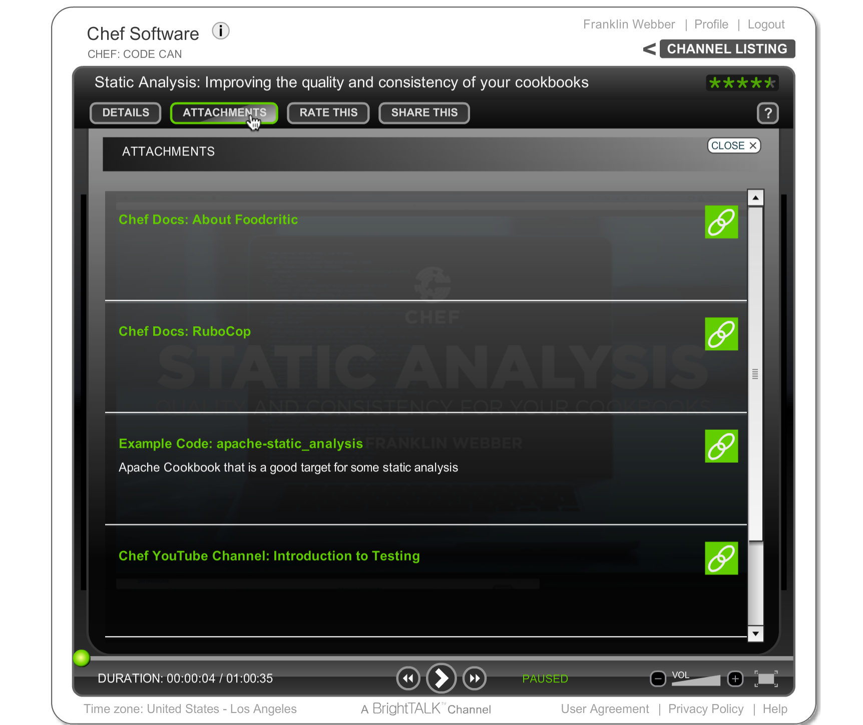
BrightTALK Attachments
All of the resources I am going to provide you can be found under "Attachments".

Slide 80
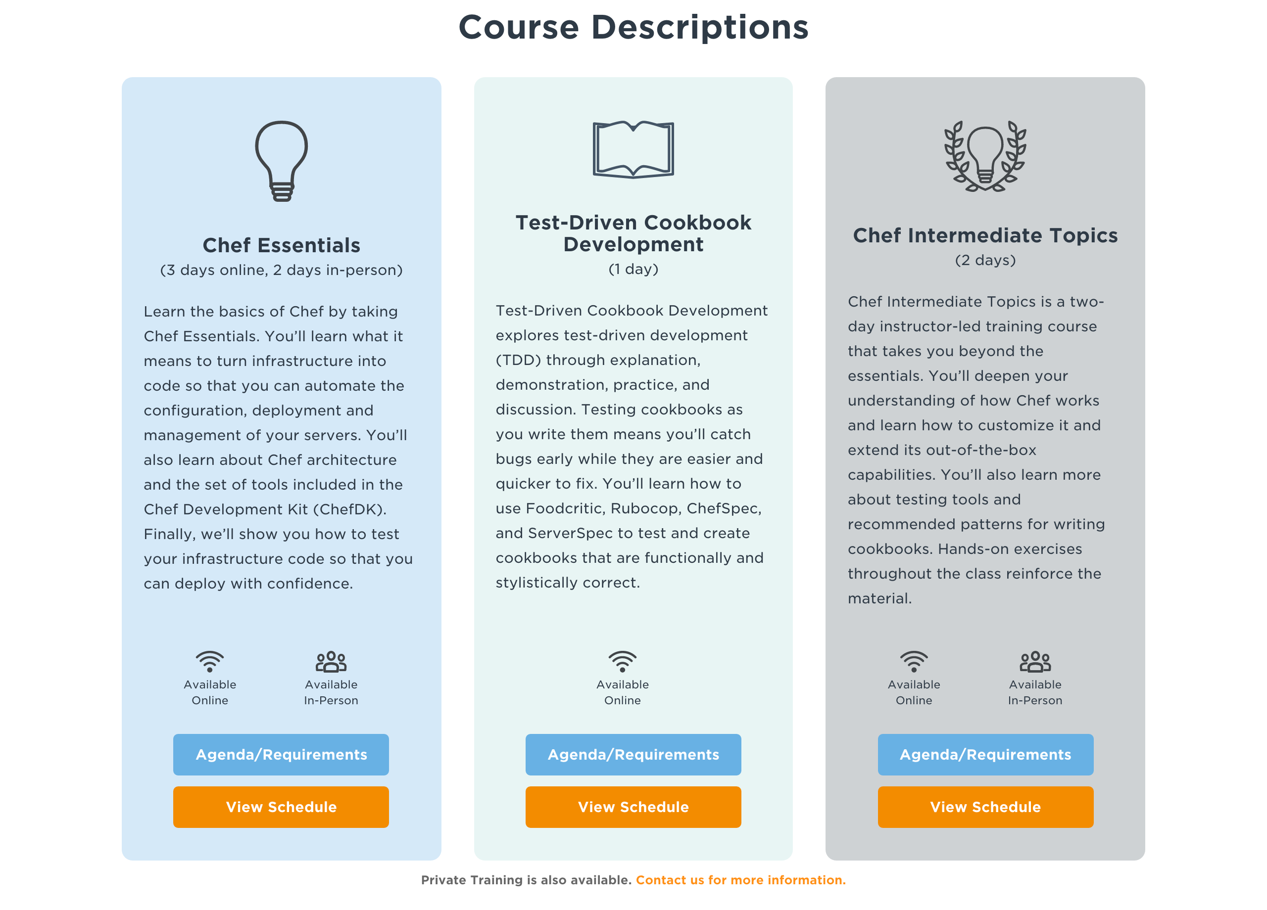
Test-Driven Cookbook Development
March 15 @ 8:00 am - 4:00 pm (PST)
Sign up at https://www.chef.io/training
Use the code TDDWEB to take 15% off the cost of the course.

Slide 81
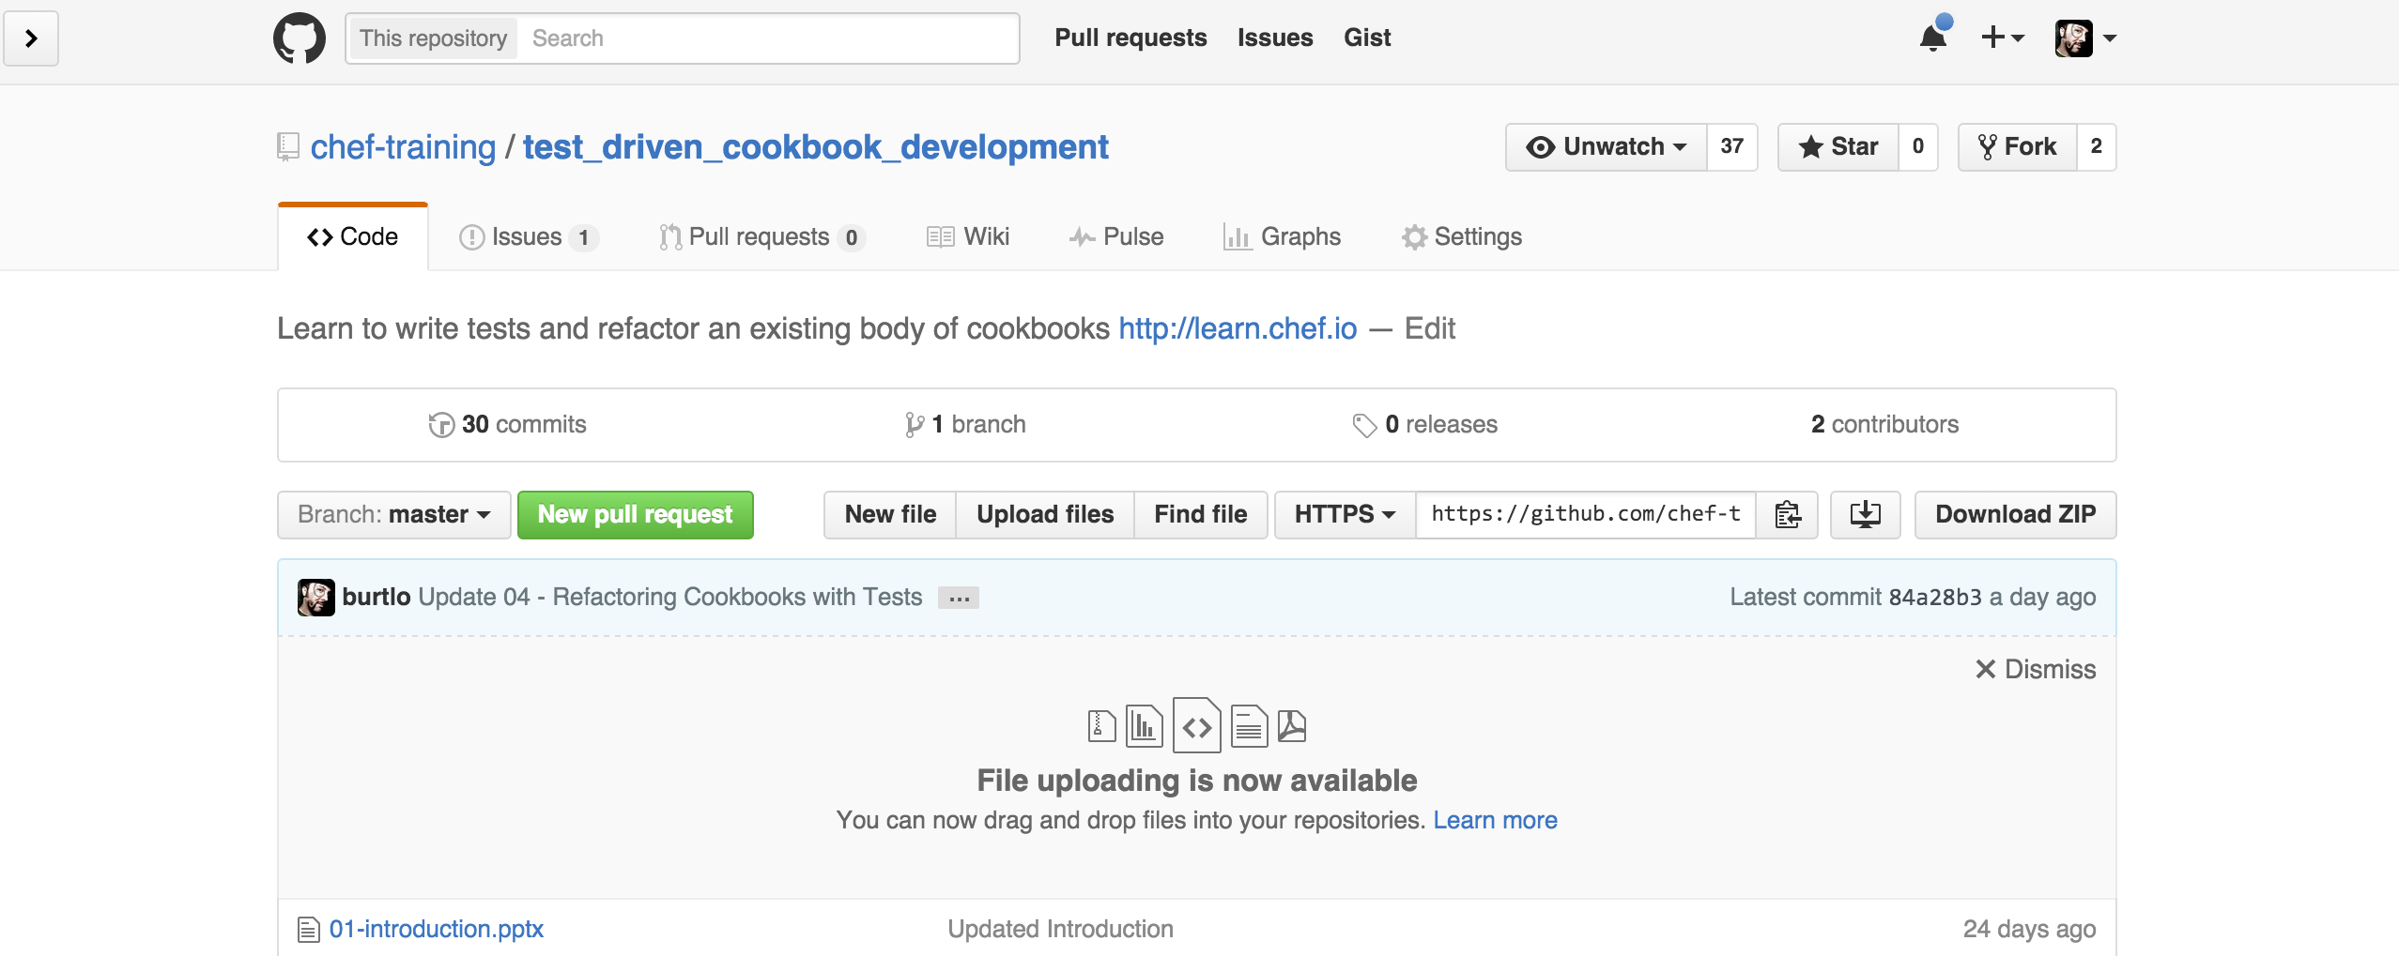
Test-Driven Cookbook Development
All the slides and the training content can be found on GitHub:
https://github.com/chef-training/test_driven_cookbook_development

Slide 82
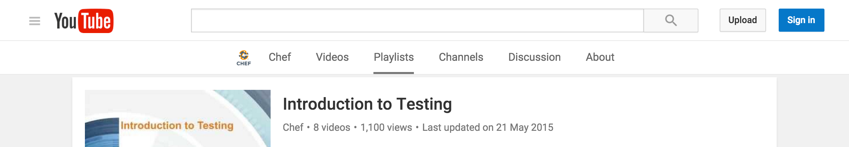
Webinars and Training Videos
Watch more Webinars.
Static Analysis - https://www.chef.io/webinars/?commid=175731
Test Kitchen - https://www.chef.io/webinars/?commid=167803
Visit and Subscribe to the Chef YouTube channel.
https://www.youtube.com/user/getchef/playlists

Slide 83
Testing Language Documentation
RSpec Documentation (https://relishapp.com/rspec)
ChefSpec Documentation (https://github.com/sethvargo/chefspec)
InSpec Documentation (https://docs.chef.io/inspec_reference.html)
ServerSpec Documentation (http://serverspec.org/resource_types.html)

Slide 84
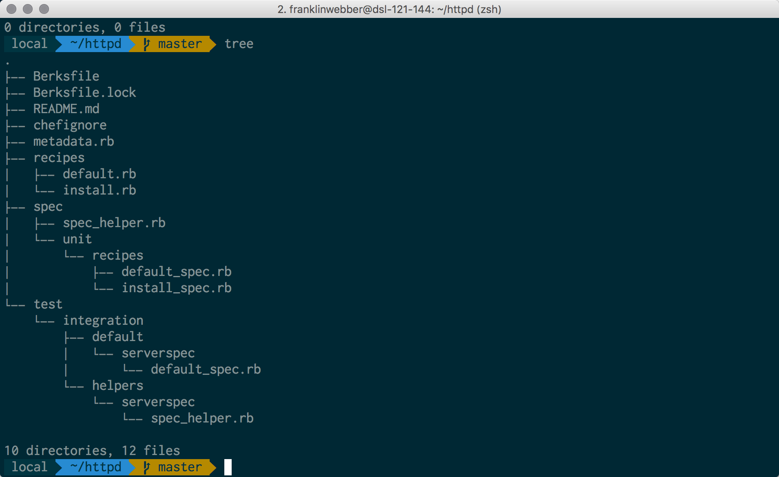
My Terminal
Mac OSX
iTerm2
Oh My Zsh
Agnoster Theme
Powerline Patched Font

Slide 85
Agenda
What is Test Driven Development (TDD)?
Writing a test first
Refactoring with tests
Faster Feedback with Unit Tests
Further Resources

Slide 86
